Slide 1

CS 677 Final Project
By: Michael Moreno

Slide 2
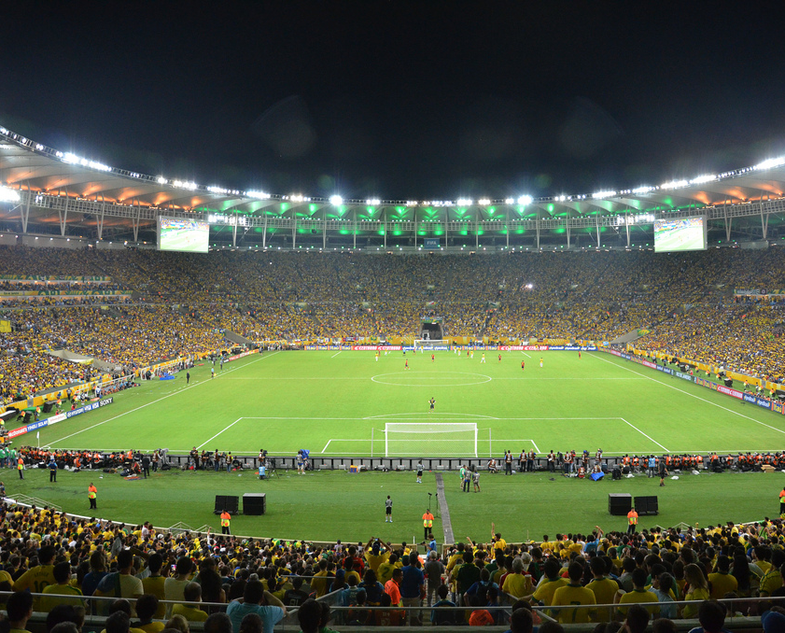
Introduction
Want to use machine learning to see if “home-field advantage” plays any role in whether an international football (soccer) team gets a positive result.
Data used:
“International Football Results from 1872 to 2024” on Kaggle
Will only be looking at matches from the 21st century
Positive result = win/draw
Negative result = loss
Three classifier models: logistic regression, decision trees, random forests

Slide 3
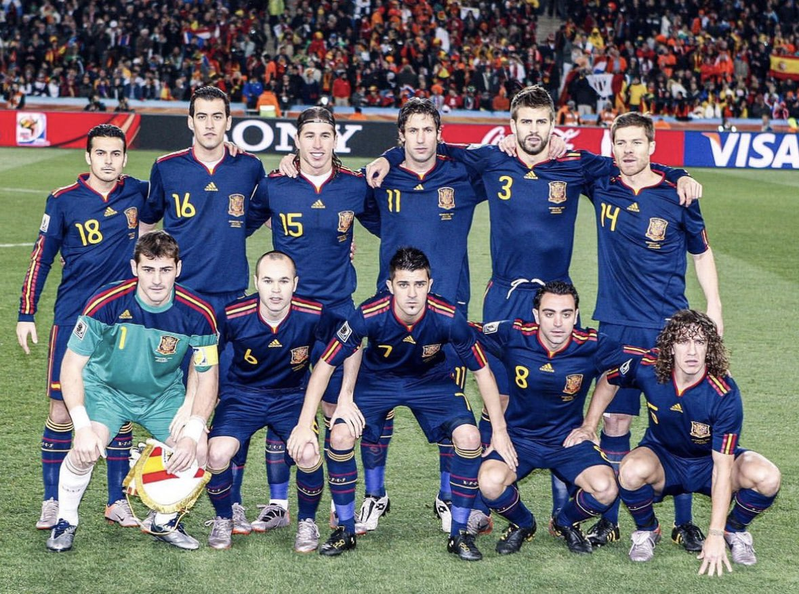
Data Specifications
Initial data file included matches played across 150 years, so I decided to analyze results from the 21st century only
At the time of download, the data file’s last matches were played on March 26, 2024, so these will be the last matches included in the classifications
Solely looking at Men’s International Team matches
Excludes matches played at a neutral venue (no home or away team)

Slide 4
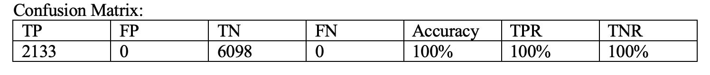
Logistic Regression Model
High accuracy, TPR, and TNR rate
Model performed excellently in predicting values
Could suggest ”home-field advantage” played a role in whether a team got a positive result

Slide 5
Decision Trees Model
High accuracy, TPR, and TNR rate
Model performed excellently in predicting values
Could suggest ”home-field advantage” played a role in whether a team got a positive result

Slide 6
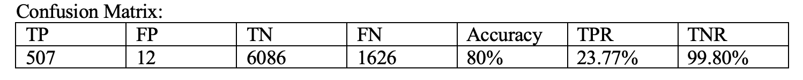
Random Forests Model
Moderately high accuracy, very low TPR, and high TNR rate
Model did well in predicting negative results but struggled predicting positive results

Slide 7

Conclusion
Logistic regression and decision trees were the best at predicting values
I would opt for logistic regression because it is the best at providing binary classification (positive result or negative result)
Based on data from the 21st century, “home-field advantage” does play a significant role in whether an international soccer team gets a win/draw

Slide 8
Thank You!

